Slide 1

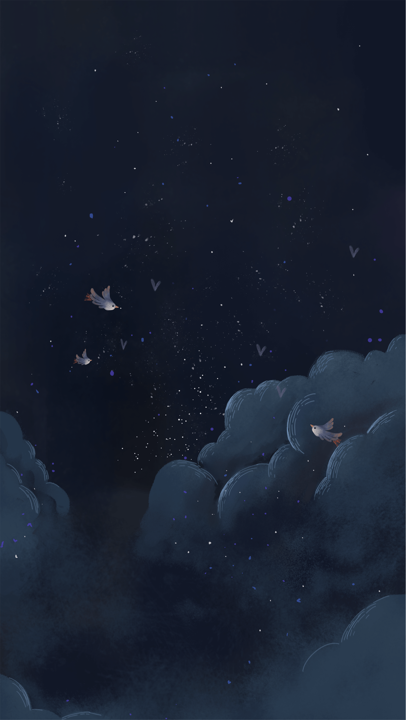




“Assalam-U-Alaikum”
“Assalam-U-Alaikum”

Slide 2

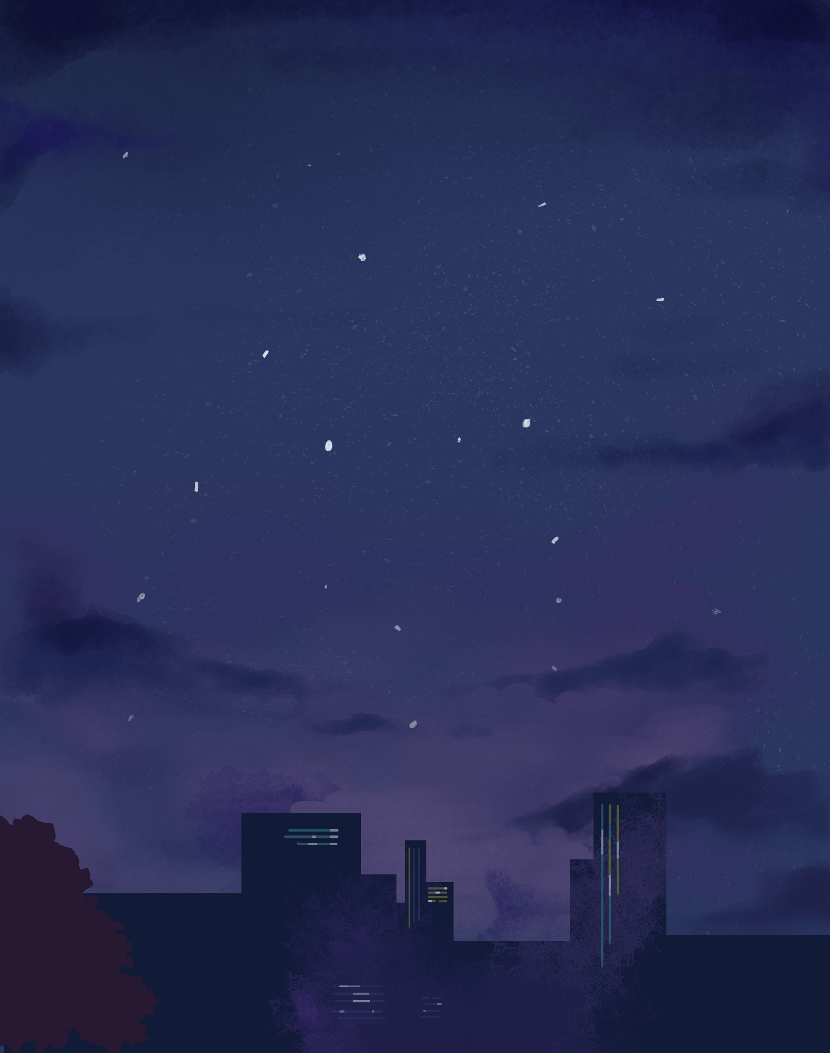



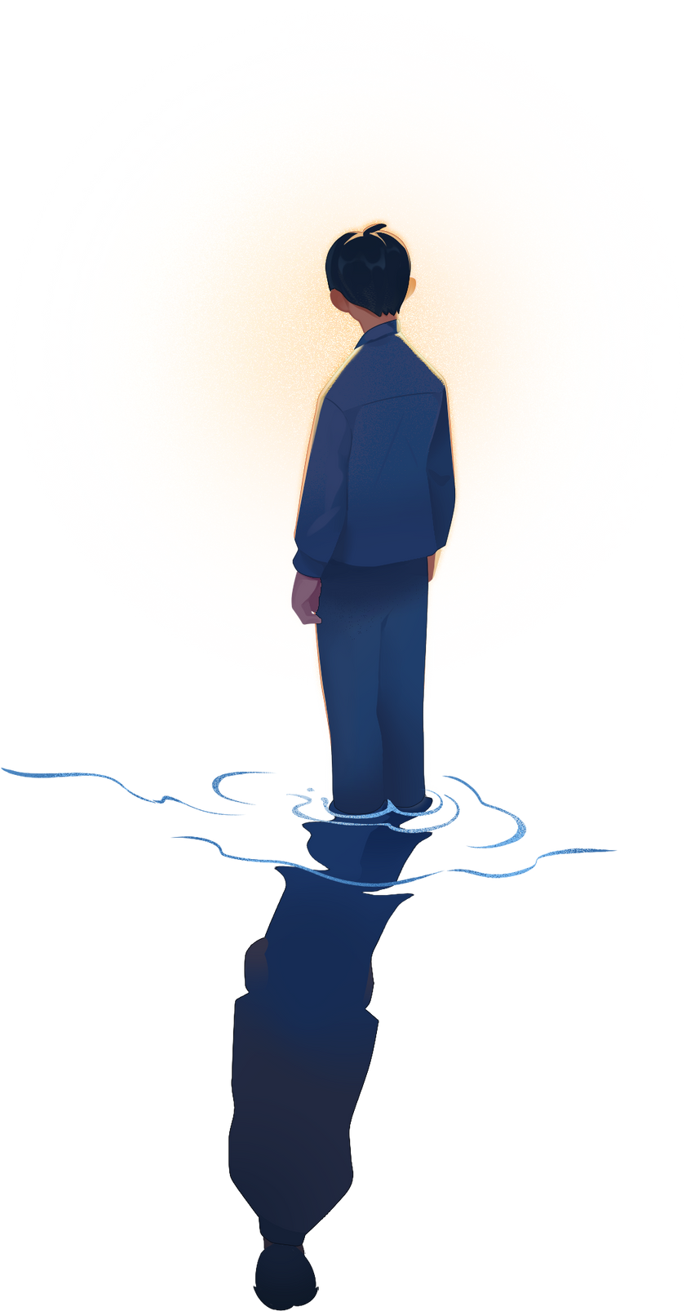


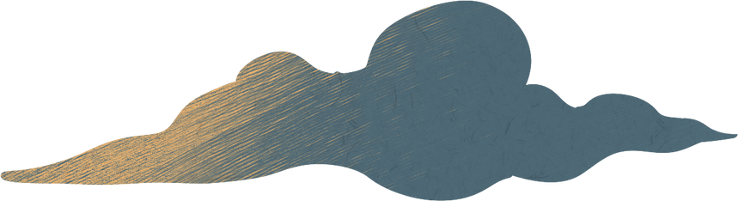
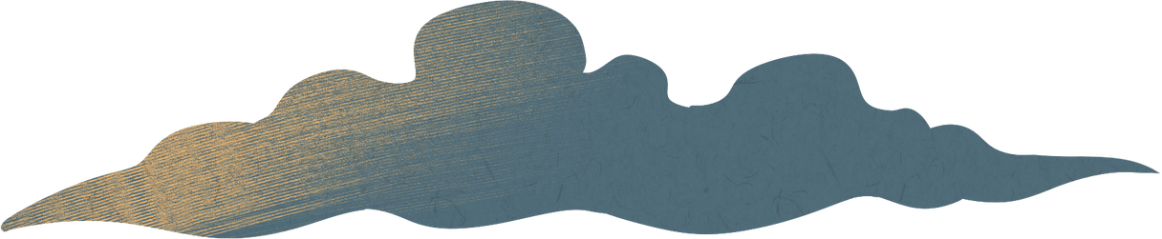
“Civic & Community Project”
“Civic & Community Project”
Ramadan Iftar Drive 2k25
Ramadan Iftar Drive 2k25
Presented By
Muhammad Maauz Mansoor
Roll No 233599
Presented By
Muhammad Maauz Mansoor
Roll No 233599

Slide 3







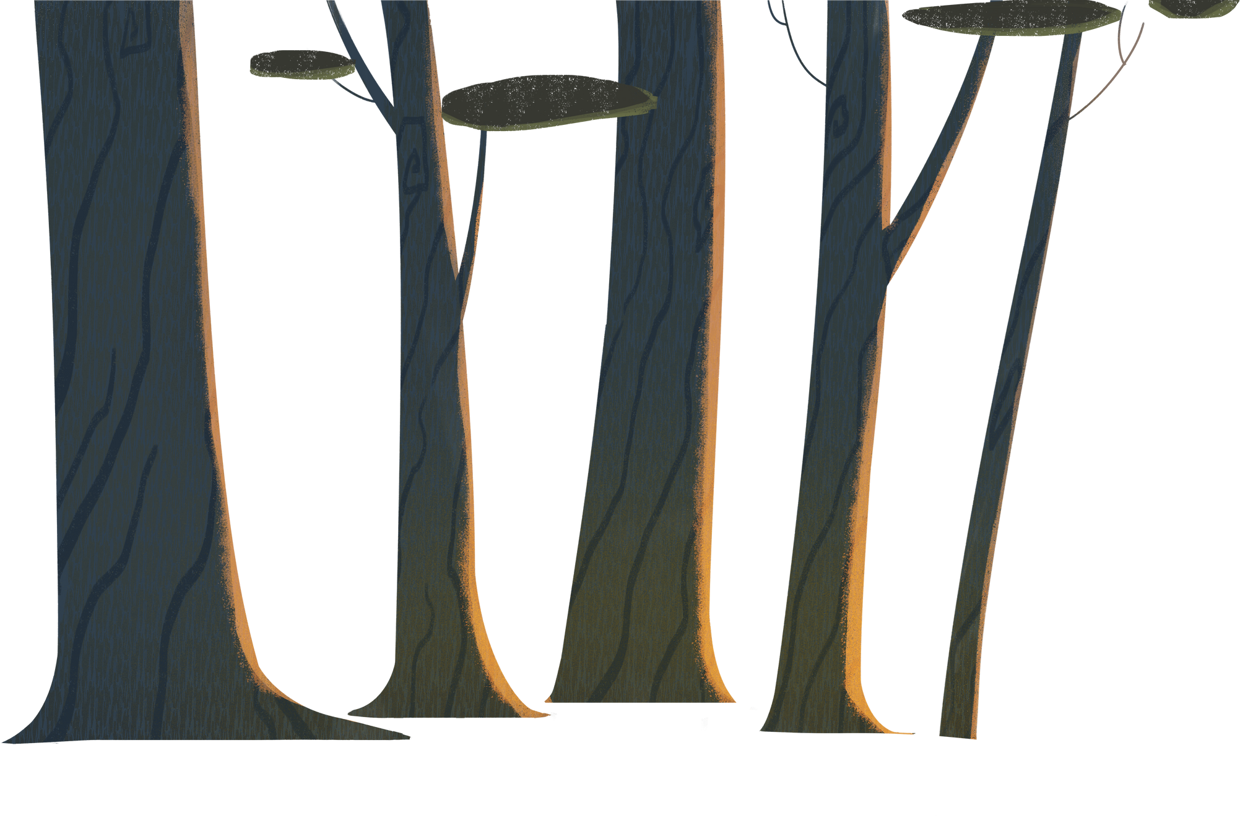
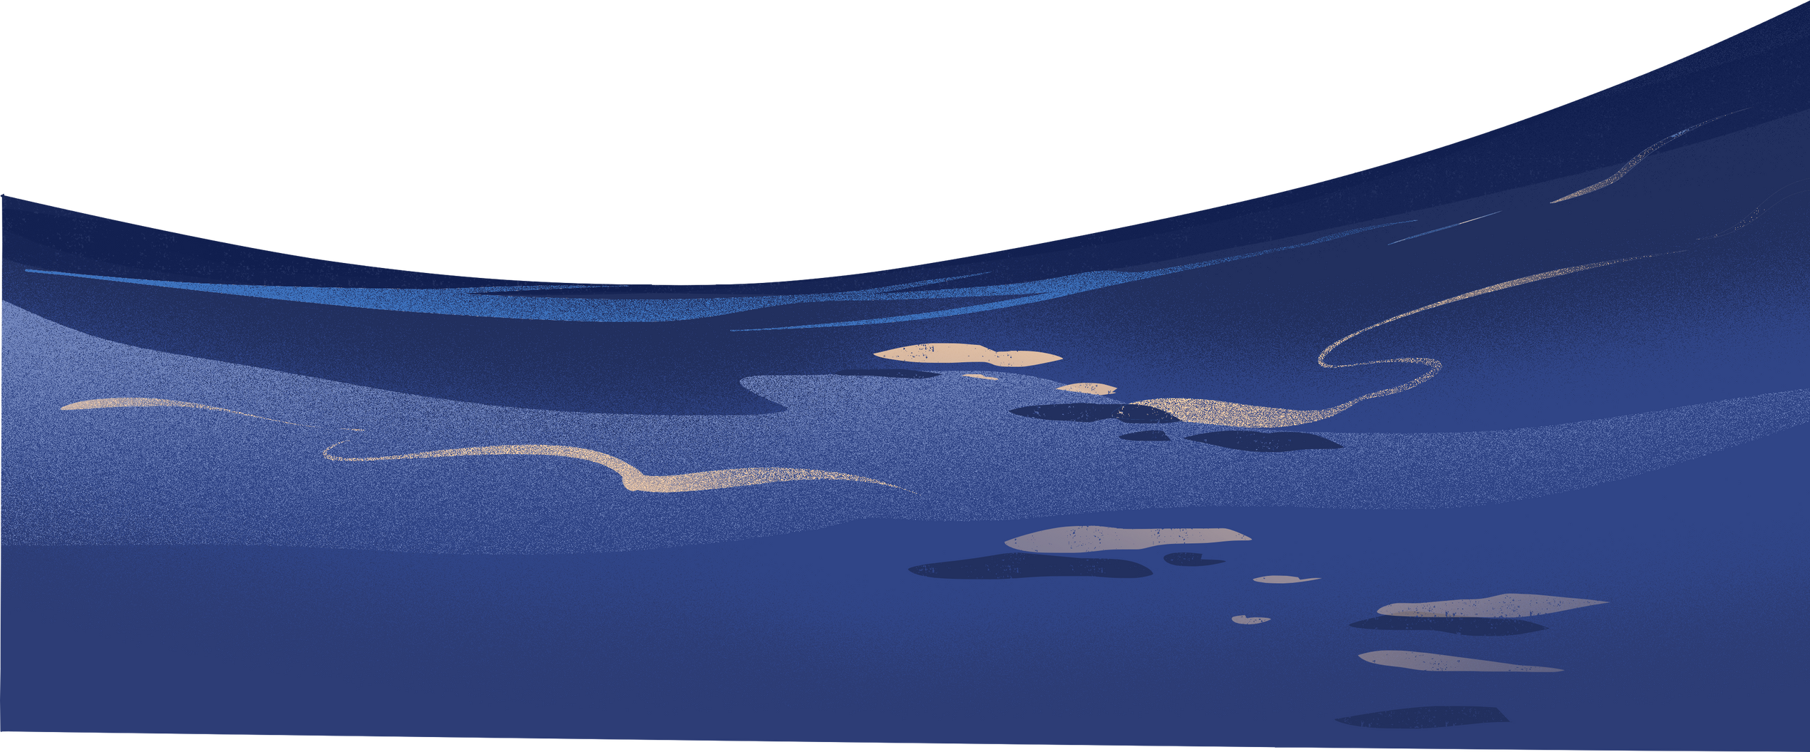



“Introduction”
As part of the Civics and Community course, I initiated and executed a large-scale Iftar Drive throughout the holy month of Ramadan 2025. Collaborating with RSWS, RAS Society, and BZU's student society, we successfully arranged Iftar for over 1000 people every Sunday. This project aimed to serve the community, promote unity, and revive the spirit of giving.
“Qoute”
“The best of people are those who bring the most benefit to others.”
Prophet Muhammad (PBUH)

Slide 4
“🌟Project Objective🌟”
“🌟Project Objective🌟”
To promote the spirit of community welfare and empathy during the holy month of Ramadan.
To provide Iftar to the underprivileged and fasting individuals in Multan.
To involve students in meaningful social responsibility initiatives.
To collaborate with multiple societies to ensure maximum impact.

Slide 5
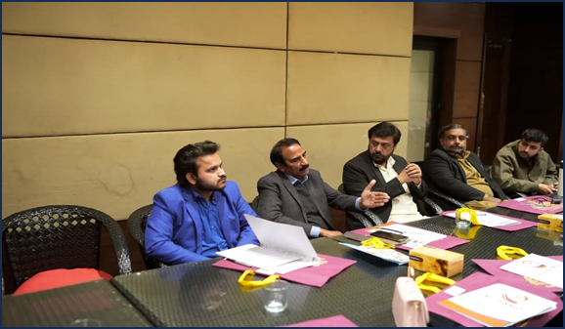
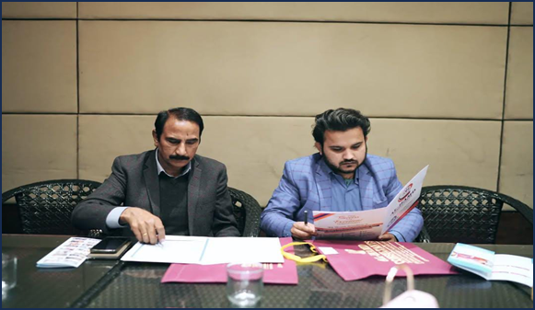
“🌟Planning & Preparation🌟”
“🌟Planning & Preparation🌟”
Weeks before Ramadan, we started planning with RSWS and RAS Society. Key steps included:
Selecting locations across Multan.
Budget planning and fundraising.
Volunteering teams formation.
Procurement of Iftar items.
Daily Coordination With Society Heads

Slide 6
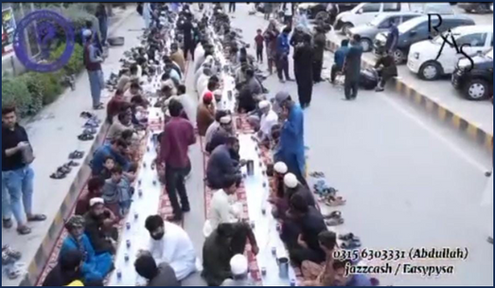
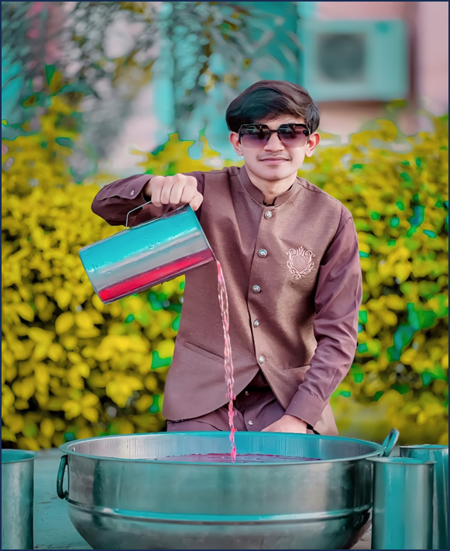
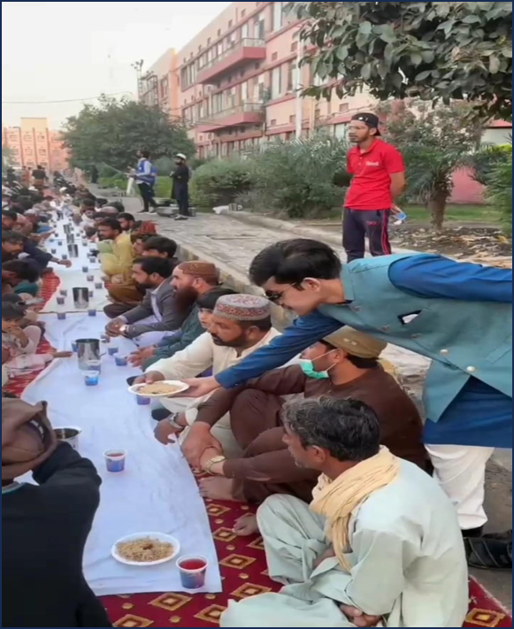
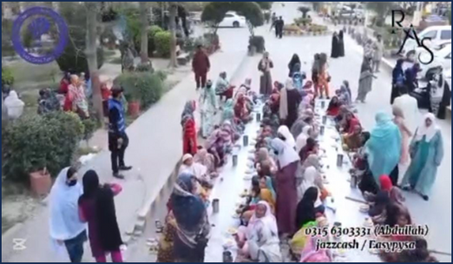
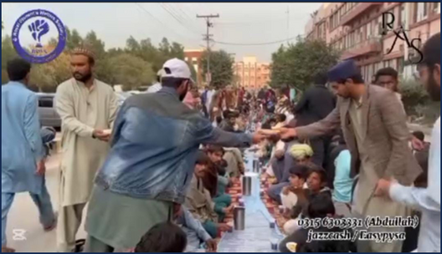
“🌟Execution & Location🌟”
“🌟Execution & Location🌟”
Each Sunday, our team set up Iftar at Nishter Hospital. Our volunteers reached the spot 2 hours before Maghrib to prepare and arrange everything. Each spot served over 1000 people, distributing dates, and biryani boxes.

Slide 7
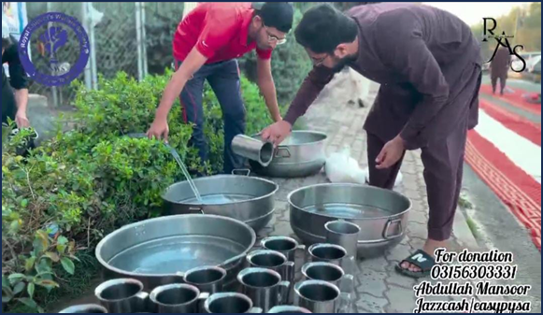
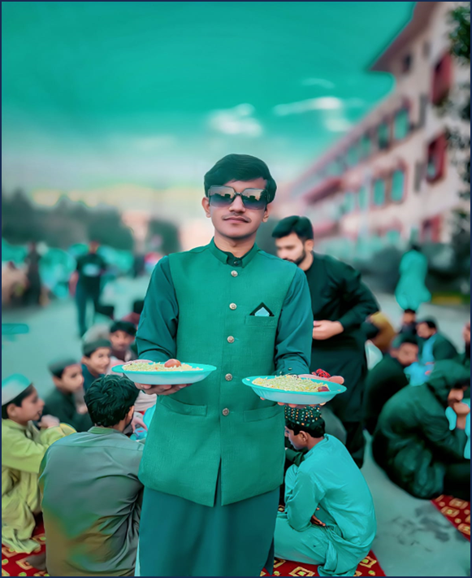
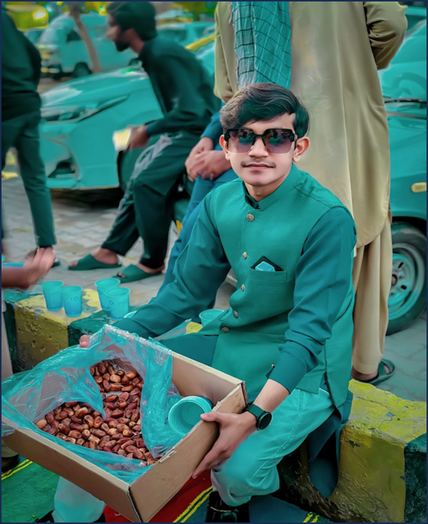
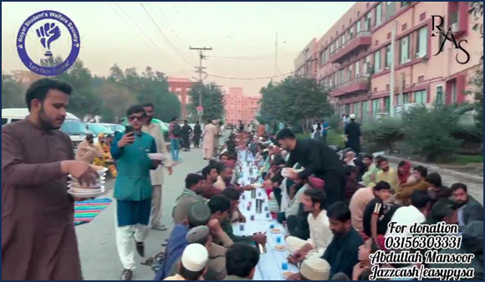
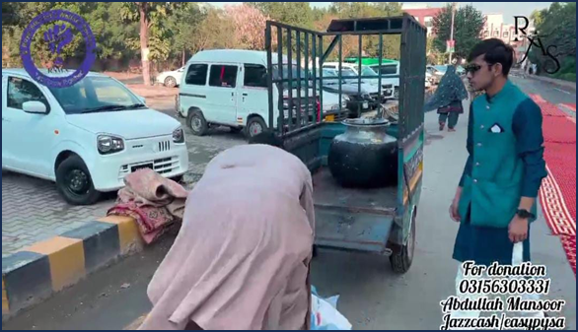
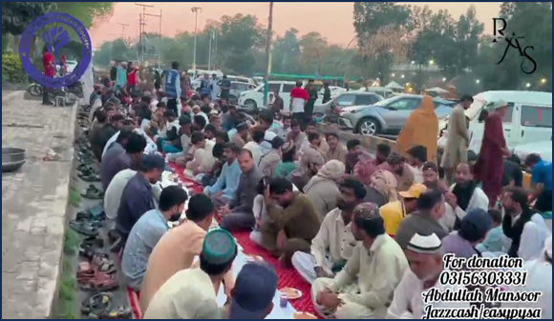
“🌟Visual Evidence🌟”
“🌟Visual Evidence🌟”

Slide 8
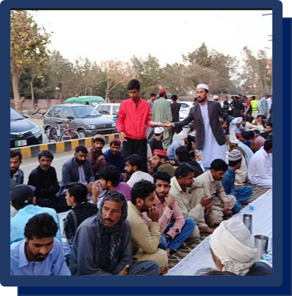
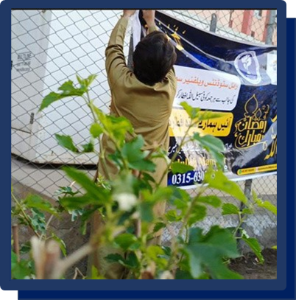
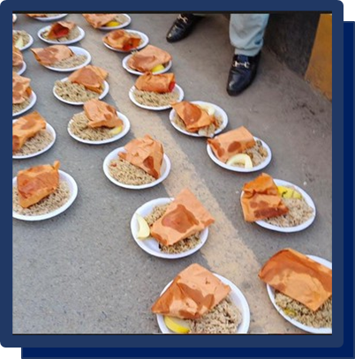
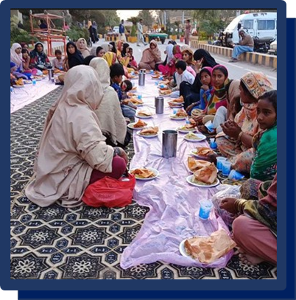
“🌟High-Lights Iftar-01🌟”
“🌟High-Lights Iftar-01🌟”

Slide 9
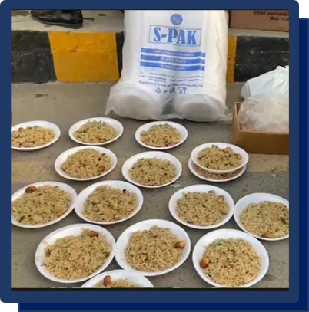
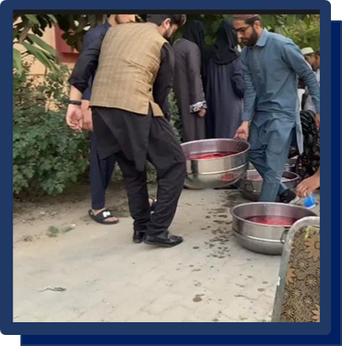
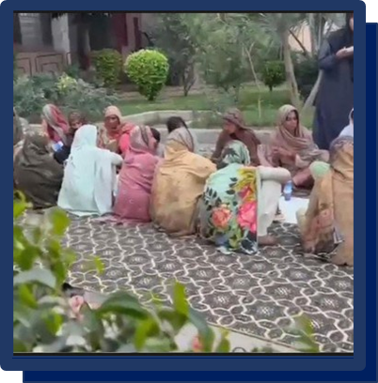
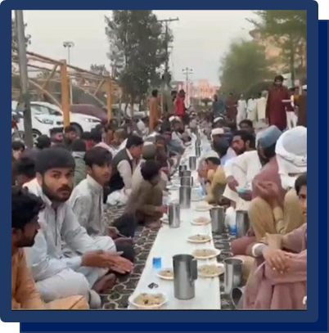
“🌟High-Lights Iftar-02🌟”
“🌟High-Lights Iftar-02🌟”

Slide 10
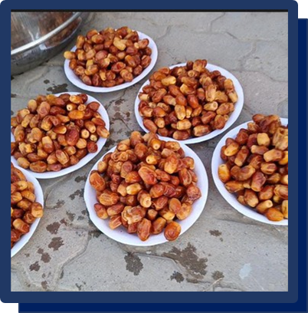
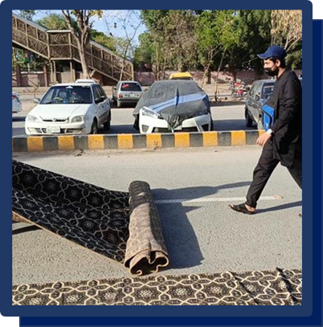
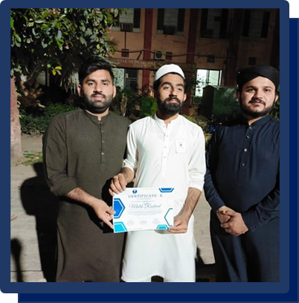
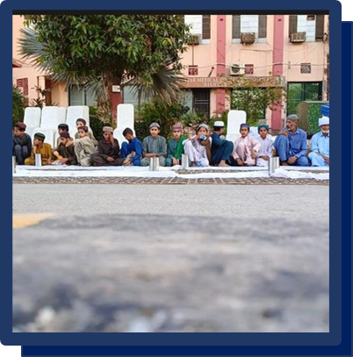
“🌟High-Lights Iftar-03🌟”
“🌟High-Lights Iftar-03🌟”

Slide 11
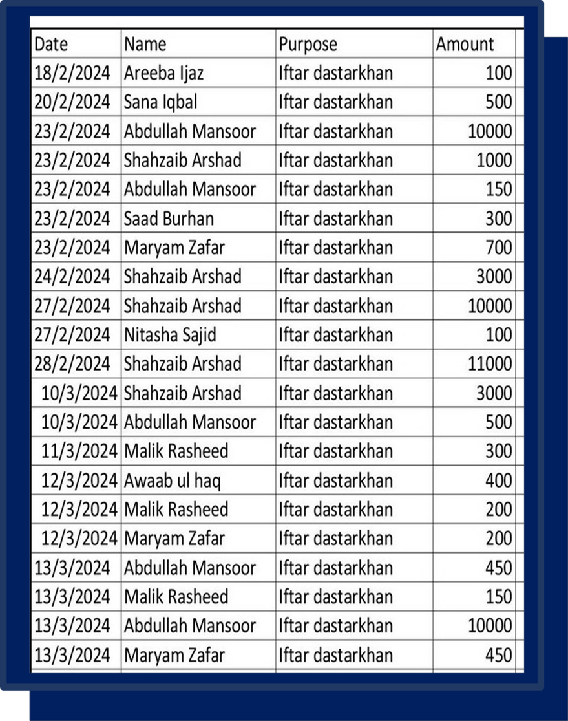
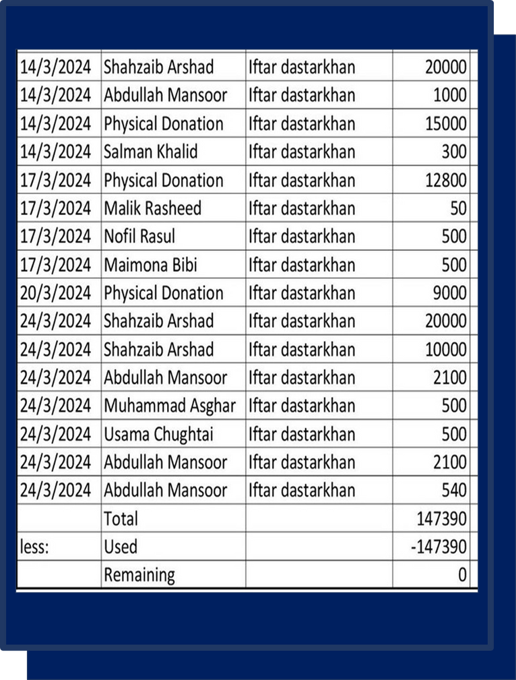

“🌟Donation Record Overall🌟”
“🌟Donation Record Overall🌟”

Slide 12

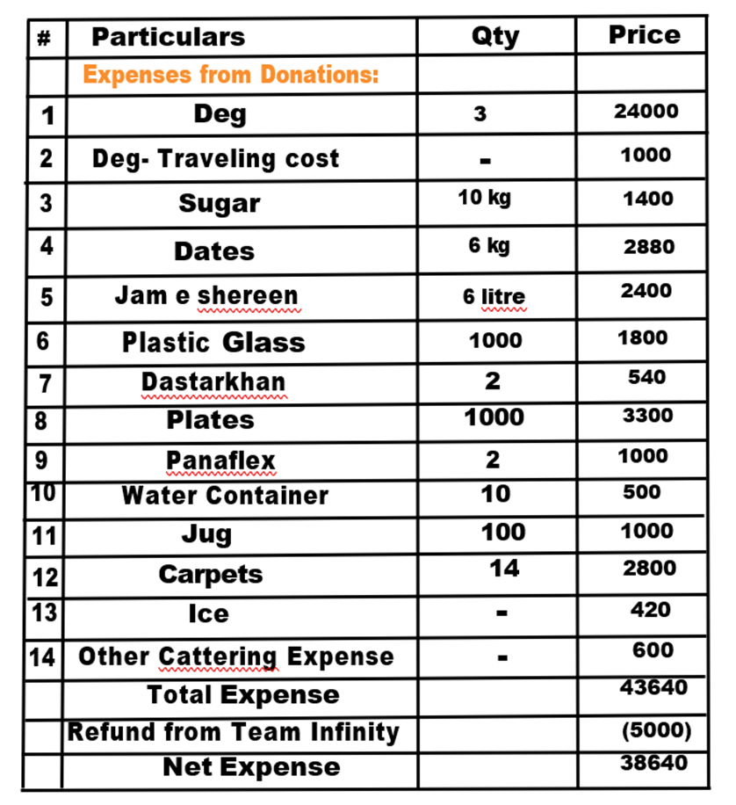
“🌟Expense Record Iftar-01🌟”
“🌟Expense Record Iftar-01🌟”

Slide 13
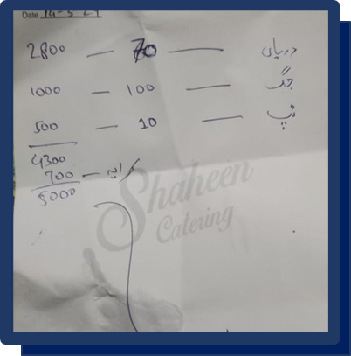
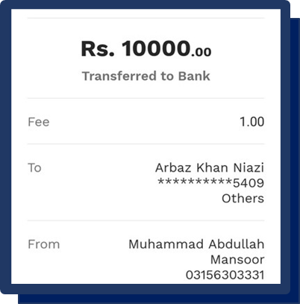
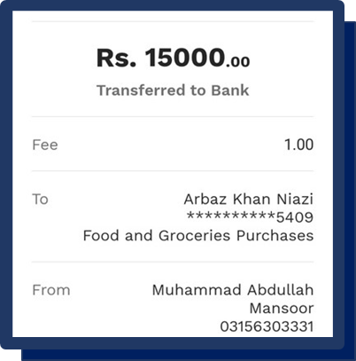
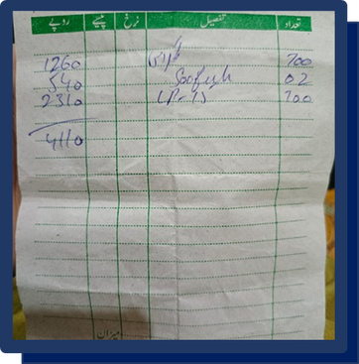
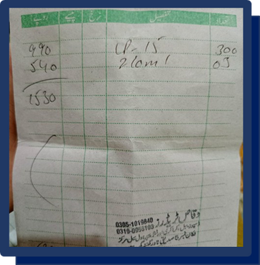
“🌟Expense Proof Iftar-01🌟”
“🌟Expense Proof Iftar-01🌟”

Slide 14
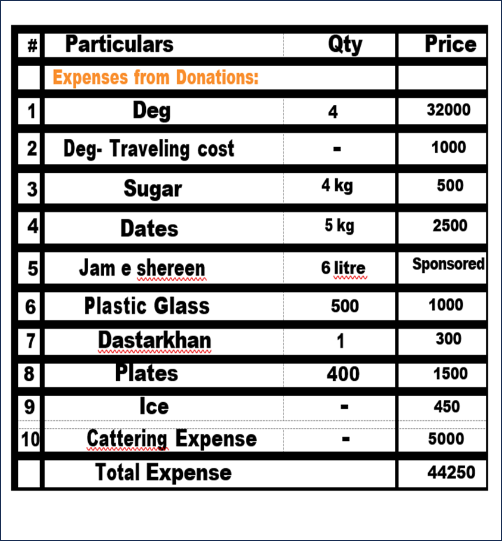
“🌟Expense Record Iftar-02🌟”
“🌟Expense Record Iftar-02🌟”

Slide 15
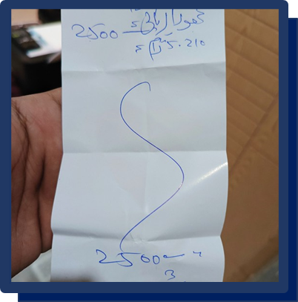
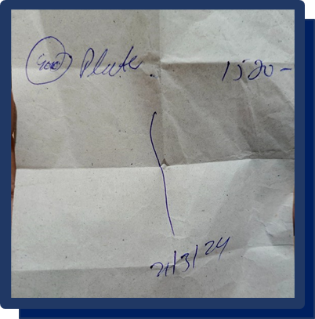
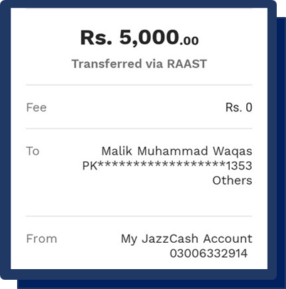
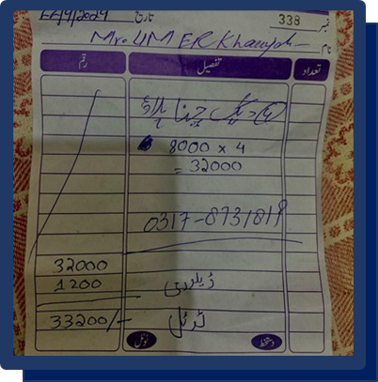
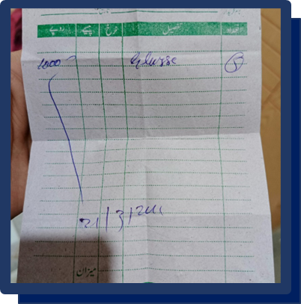
“🌟Expense Proof Iftar-02🌟”
“🌟Expense Proof Iftar-02🌟”

Slide 16
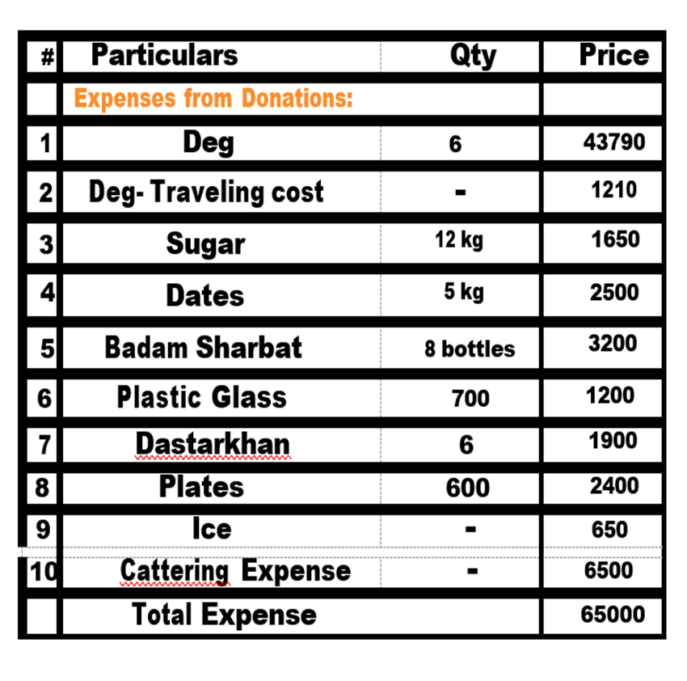
“🌟Expense Record Iftar-03🌟”
“🌟Expense Record Iftar-03🌟”

Slide 17
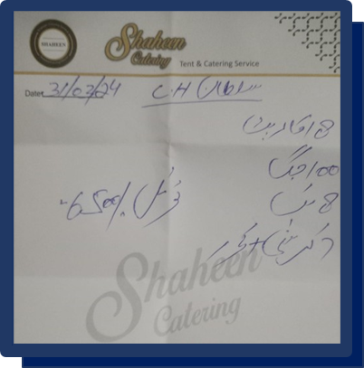
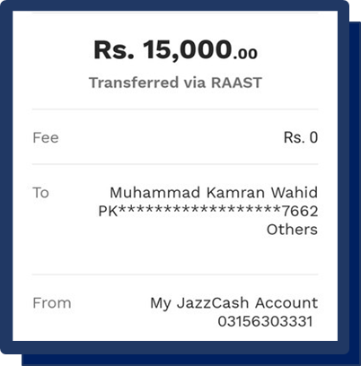
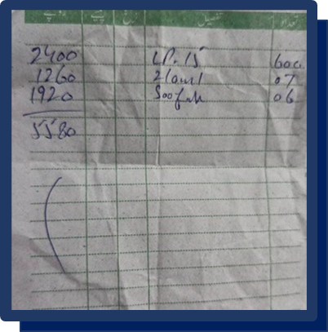

“🌟Expense Proof Iftar-03🌟”
“🌟Expense Proof Iftar-03🌟”

Slide 18
“🌟Community Impact & FeedBack🌟”
“🌟Community Impact & FeedBack🌟”
The impact of the Iftar Drive was far greater than we could have imagined. As the sun set and people broke their fasts with the food we provided, their eyes reflected gratitude and relief. Many came forward to thank us — not just with words, but with heartfelt duas and emotional smiles. Some shared their stories of hardship, reminding us why such initiatives are not just necessary but sacred.
Volunteers, too, underwent a transformation. For many, it was their first time serving others on such a scale. They expressed how fulfilling it felt to give back, how the sense of unity made them feel connected not just to the community but also to something much bigger — a collective sense of purpose. This project became a mirror that reflected humanity at its best: selfless, united, and compassionate.
“Qoute”
"No act of kindness, no matter how small, is never wasted."
Aesop

Slide 19
“🌟Aknowledgement🌟”
“🌟Aknowledgement🌟”
A heartfelt thank you to RSWS, RAS Society, and BZU Student Society, our pillars of strength and collaboration. Without your endless support, dedication, and shared vision, this drive would not have reached the heights it did. This journey would not have been the same without each one of you.
“Qoute”
“Alone we can do so little; together we can do so much.”
Helen Keller

Slide 20

“🌙 Video Links ”
Link#1: https://www.instagram.com/reel/DGuHfJpoUX6/?igsh=MXE2dDE3bG9idGppaw==
Link#2: https://www.instagram.com/reel/DHBMeVXTLCT/?igsh=MXBpcGUzeTB4djRheg==
Link#3: https://www.instagram.com/reel/DHUFMWwIR1s/?igsh=eW95YmZ2a3AzYnpy Link#4: https://www.instagram.com/reel/DHS0VCMsAS1/?igsh=cnVsNHRkeWxwemN0
Link#5: https://www.instagram.com/reel/DHqQZH9t2FN/?igsh=YjBrZzI3MnU3dzI0

Slide 21

“🌙 My-Certificate”
“🌙 My-Certificate”

Slide 22

“🌟Other-Activities🌟”
“🌟Other-Activities🌟”
“🌟Winter-drive 2k23🌟”

Slide 23

“🌟Organize Session at bzu🌟”

Slide 24

“🌟Old-Age Home Drive 🌟”

Slide 25

“🌟Bakra-Eid Drive🌟”

Slide 26

“🌟Winter-drive 2k24🌟”

Slide 27

“🌟Madrassah Drive🌟”

Slide 28

“🌟Orphan-Age drive🌟”

Slide 29
“🌟Conclusion🌟”
“🌟Conclusion🌟”
This Iftar Drive was not just a project — it was an experience that touched the heart, shaped character, and rekindled faith in humanity. In a world that often feels divided, this initiative reminded us of the power of unity, empathy, and collective action. The prayers we received, the tears of joy we witnessed, and the blessings we were showered with are etched in memory forever.
It changed me personally — gave me a reason to believe that even small steps can lead to big changes, that when we serve others, we heal parts of ourselves too. I walk away from this project with renewed determination to make community service not just a course requirement, but a lifelong commitment.
“Qoute”
“The smallest deed done is better than the greatest intention.”
John Burroughs

Slide 30
“🌙 Final Reflection”
“🌙 Final Reflection”
"Feeding a hungry soul is not just charity — it is a silent prayer that rises beyond the skies. Maybe your one biryani box ended a mother’s wait for food... maybe your quiet smile eased the pain in someone’s heart. To provide Iftar during Ramadan is not merely a gesture — it could be the very deed that wipes away a lifetime of sins."
“And spend [in the way of Allah] from what We have provided you before death approaches one of you…”
Surah Al-Munafiqun (63:10)

Slide 31
Thank You

